Slide 1
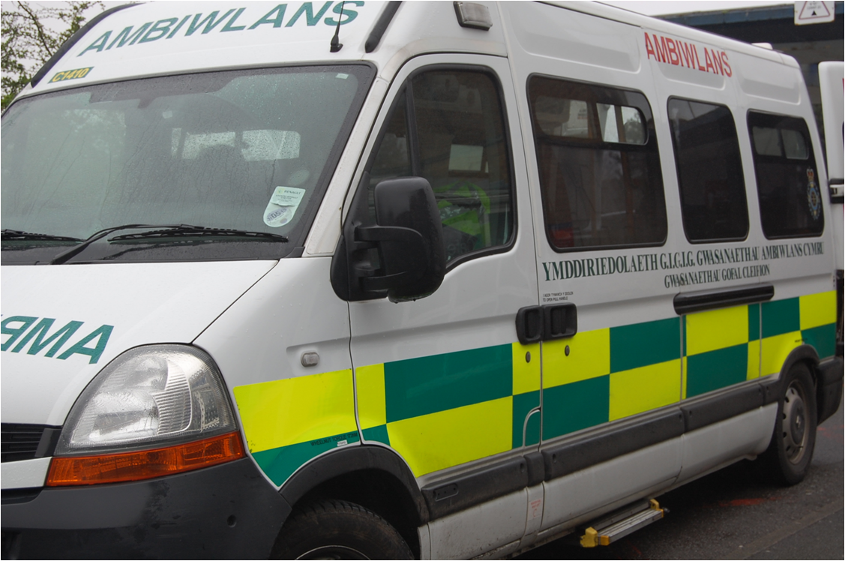
Booking Transport
To Serennu
This leaflet gives you advice if you want support getting to and from medical and therapy appointments at Serennu Children’s Centre.
Non emergency transport is provided to patients who have a medical or mobility need.
It is important that you only use this service if you have no other means of getting your child to Serennu.

Slide 2
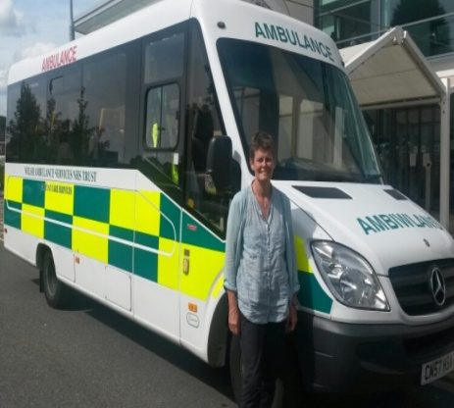
Q
How do I arrange Ambulance Transport?
A
Please make sure you contact us as soon as you receive your
appointment letter.
You can make your booking up to 3 months in advance of your appointment. If you have been given an urgent appointment, do not worry, contact this number as soon as possible. We can take bookings up to 2pm on the day before your appointment.
When you call, please inform us immediately that your appointment is at Serennu and have the following information about your child available:
NHS number
Home postcode
Date of birth
Telephone number
The date and time of your appointment
The name of the department being attended in Serennu
Your local booking numbers are:
0300 100 0012 or 01633 748000
Q
What time should I be ready for collection?
A
When you make your transport request, you will be given an
indication of what time to be ready.
Q
What type of vehicle will I be travelling on?
A
A variety of vehicles are available and we will discuss with you the most appropriate vehicle to meet your needs.
Our vehicles can accommodate wheelchairs and those who need a stretcher. It is important that we have the most up to date information on your mobility to send the correct type of vehicle for you.
Space is very limited so please keep your
baggage to a minimum where possible.

Slide 3
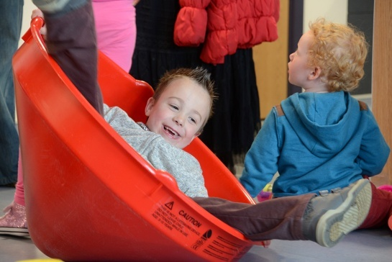
Q
Can I bring someone with me?
A
Your child will have to be accompanied by an adult. If your child requires more than one escort please ensure that you inform the operator at the time of the booking.
Please be aware that every seat may be needed by another patient. Please ask any family or friends to meet up with you at the clinic you are attending where possible.
Q
Who will pick me up?
A
You will be transported to your appointment by the most appropriate available vehicle to meet your medical and mobility needs.
Q
Who will collect me to go home?
A
The expected pick-up time for your return journey will be planned according to the anticipated duration of the appointment you are attending. In addition, whenever possible, Serennu will inform us that you are ready to go, just pop back to reception when your appointment has ended and we will make every effort to pick you up as soon as possible. During busy periods you may need to wait longer, however we will always try to keep you up to date with any delays.
As there may be a number of patients on the vehicle, there may be a delay in returning you to your destination.
Q
What if I can’t make my appointment?
A
Please contact us as soon as possible using the number on this leaflet and tell us that you no longer require transport. Your seat may be used for another patient.
When booking transport don’t forget to tell us
about any additional needs your child may have.
If your child takes regular medication,
please remember to bring it with you.
We want your feedback.
Please visit our website and click on
Have Your Say.
www.ambulance.wales.nhs.uk

